Slide 1
FINAL PROJECT PRESENTATION
LJ
LearnAIJava
AI-Assisted Java Assignment, Evaluation and Feedback System
A traceable learning loop for students and instructors
TTTU4086 Project
ZHANG PEIGEN A199958
Supervisor: Dr Syahanim Mohd Salleh
No personal information is displayed
Notes:
[00:00-00:40]
Good morning or good afternoon, respected panel members. Thank you for the opportunity to present LearnAIJava. LearnAIJava is an AI-assisted Java assignment, evaluation and feedback system. It helps beginners understand why code fails and gives instructors traceable evidence of attempts and progress. In the next ten minutes, I will cover the problem, architecture, revised models, workflow and evaluation. I will then use five minutes for a live demo with test accounts. No personal information will be shown.

Slide 2
CURRENT STATE / GAP / RESPONSE
LearnAIJava complements UKM Folio VPL with explainable learning support
TODAY
GAP
ADD
V
!
+
UKM Folio VPL
Learning gap
LearnAIJava response
Course-linked Java submission
Automated execution and tests
Test summary and grade evidence
The workflow is effective for checking whether code meets configured cases.
Pass / fail evidence shows the outcome, but beginners may still need clearer explanations of the likely cause.
Repeated attempts should also become visible learning progress.
Retains automated checking, then adds controlled feedback, weighted evidence, submission history and student/class analytics.
It complements the existing Folio workflow.
2
Notes:
[00:40-01:35]
UKM Folio VPL already provides an established course-linked workflow for Java submission, automated execution, test results and grade evidence. The comparison here is not that LearnAIJava replaces Folio. The learning gap is that a beginner may still need a clearer explanation of the likely cause of a failed result, and repeated attempts should become visible progress rather than isolated outcomes. LearnAIJava therefore keeps automated checking but adds controlled diagnostic feedback, weighted evidence, submission history, and student and instructor analytics as a complementary learning-support layer.

Slide 3
SYSTEM FUNCTIONAL ARCHITECTURE
Role-specific functions run on one shared platform
LearnAIJava System
ROLE-SPECIFIC WORKFLOWS
Student
Instructor
Administrator
Join class → Run / Evaluate → Submit
Create questions + tests
Publish assignments + review
Approve instructor accounts
Feedback + score + progress
Class evidence + analytics
Approval status + audit logs
PROCESS — an action by an actor or the system that changes, checks or stores data.
OUTPUT — feedback, scores, status, records or analytics produced after a process.
3
Notes:
[01:35-02:25]
The functional architecture separates three role-specific workflows on one platform. Students access assignments, write and evaluate code, submit work and review feedback and progress. Instructors manage classes, students, private questions, tests, assignments, submissions and analytics. Administrators manage accounts, approve instructor verification and monitor system records; they do not manage students or teaching content. Shared services below these workflows provide access control, local Java execution, test evaluation, feedback, analytics and Supabase data services.

Slide 4
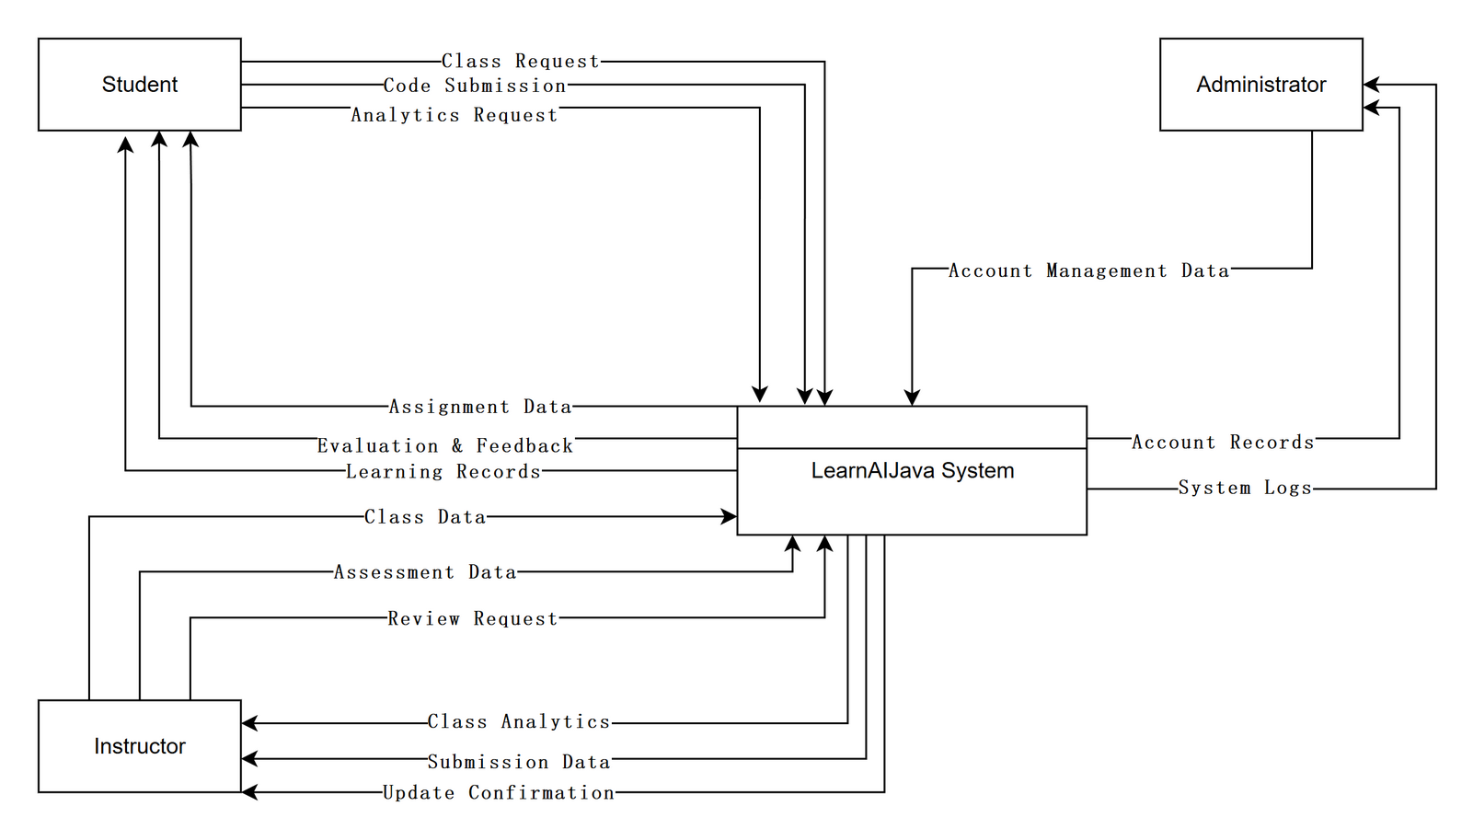
REVISED CONTEXT DIAGRAM
The system boundary contains only human user roles
Student, Instructor and Administrator exchange data with one LearnAIJava System process.
4
Notes:
[02:25-03:10]
The context diagram treats LearnAIJava as one process and shows only external human users. Students exchange class, code, evaluation, feedback and progress data. Instructors exchange class, assessment, submission and analytics data. Administrators exchange account, instructor-approval and system-record data. Databases and internal services are excluded because they sit inside the system boundary. The revised diagram also keeps the responsibility of each role clear and uses shorter data-flow names.

Slide 5
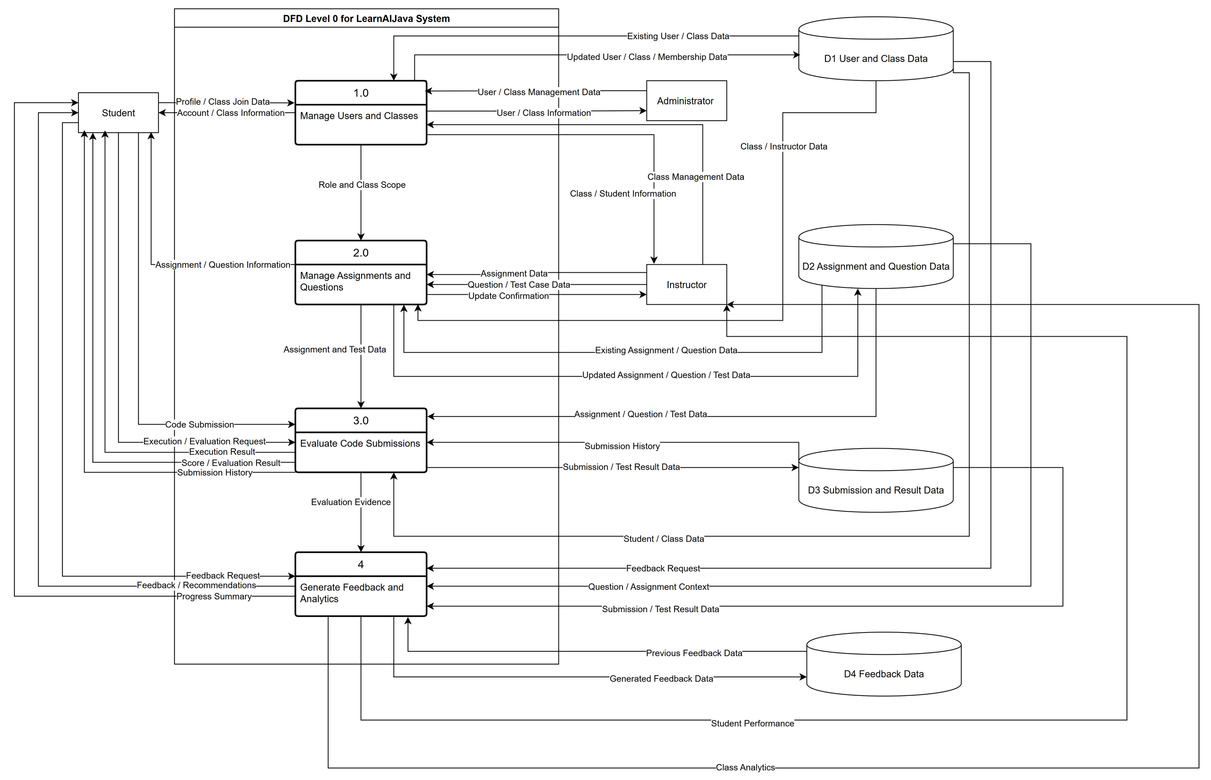
REVISED DFD LEVEL 0
Four core processes convert actions into learning evidence
D1–D4 align the four core data groups. Open editable .drawio source
5
Notes:
[03:10-04:00]
The Level 0 DFD opens the system into four processes: manage users and classes; manage assignments and questions; evaluate code submissions; and generate feedback and analytics. Four logical stores group user and class data, assignment and question data, submission and result data, and feedback data. Users never access a store directly. The main path is instructor preparation, student evaluation, result storage, then feedback and analytics. The removed administrator learning-summary flow is not shown because it is not implemented.

Slide 6
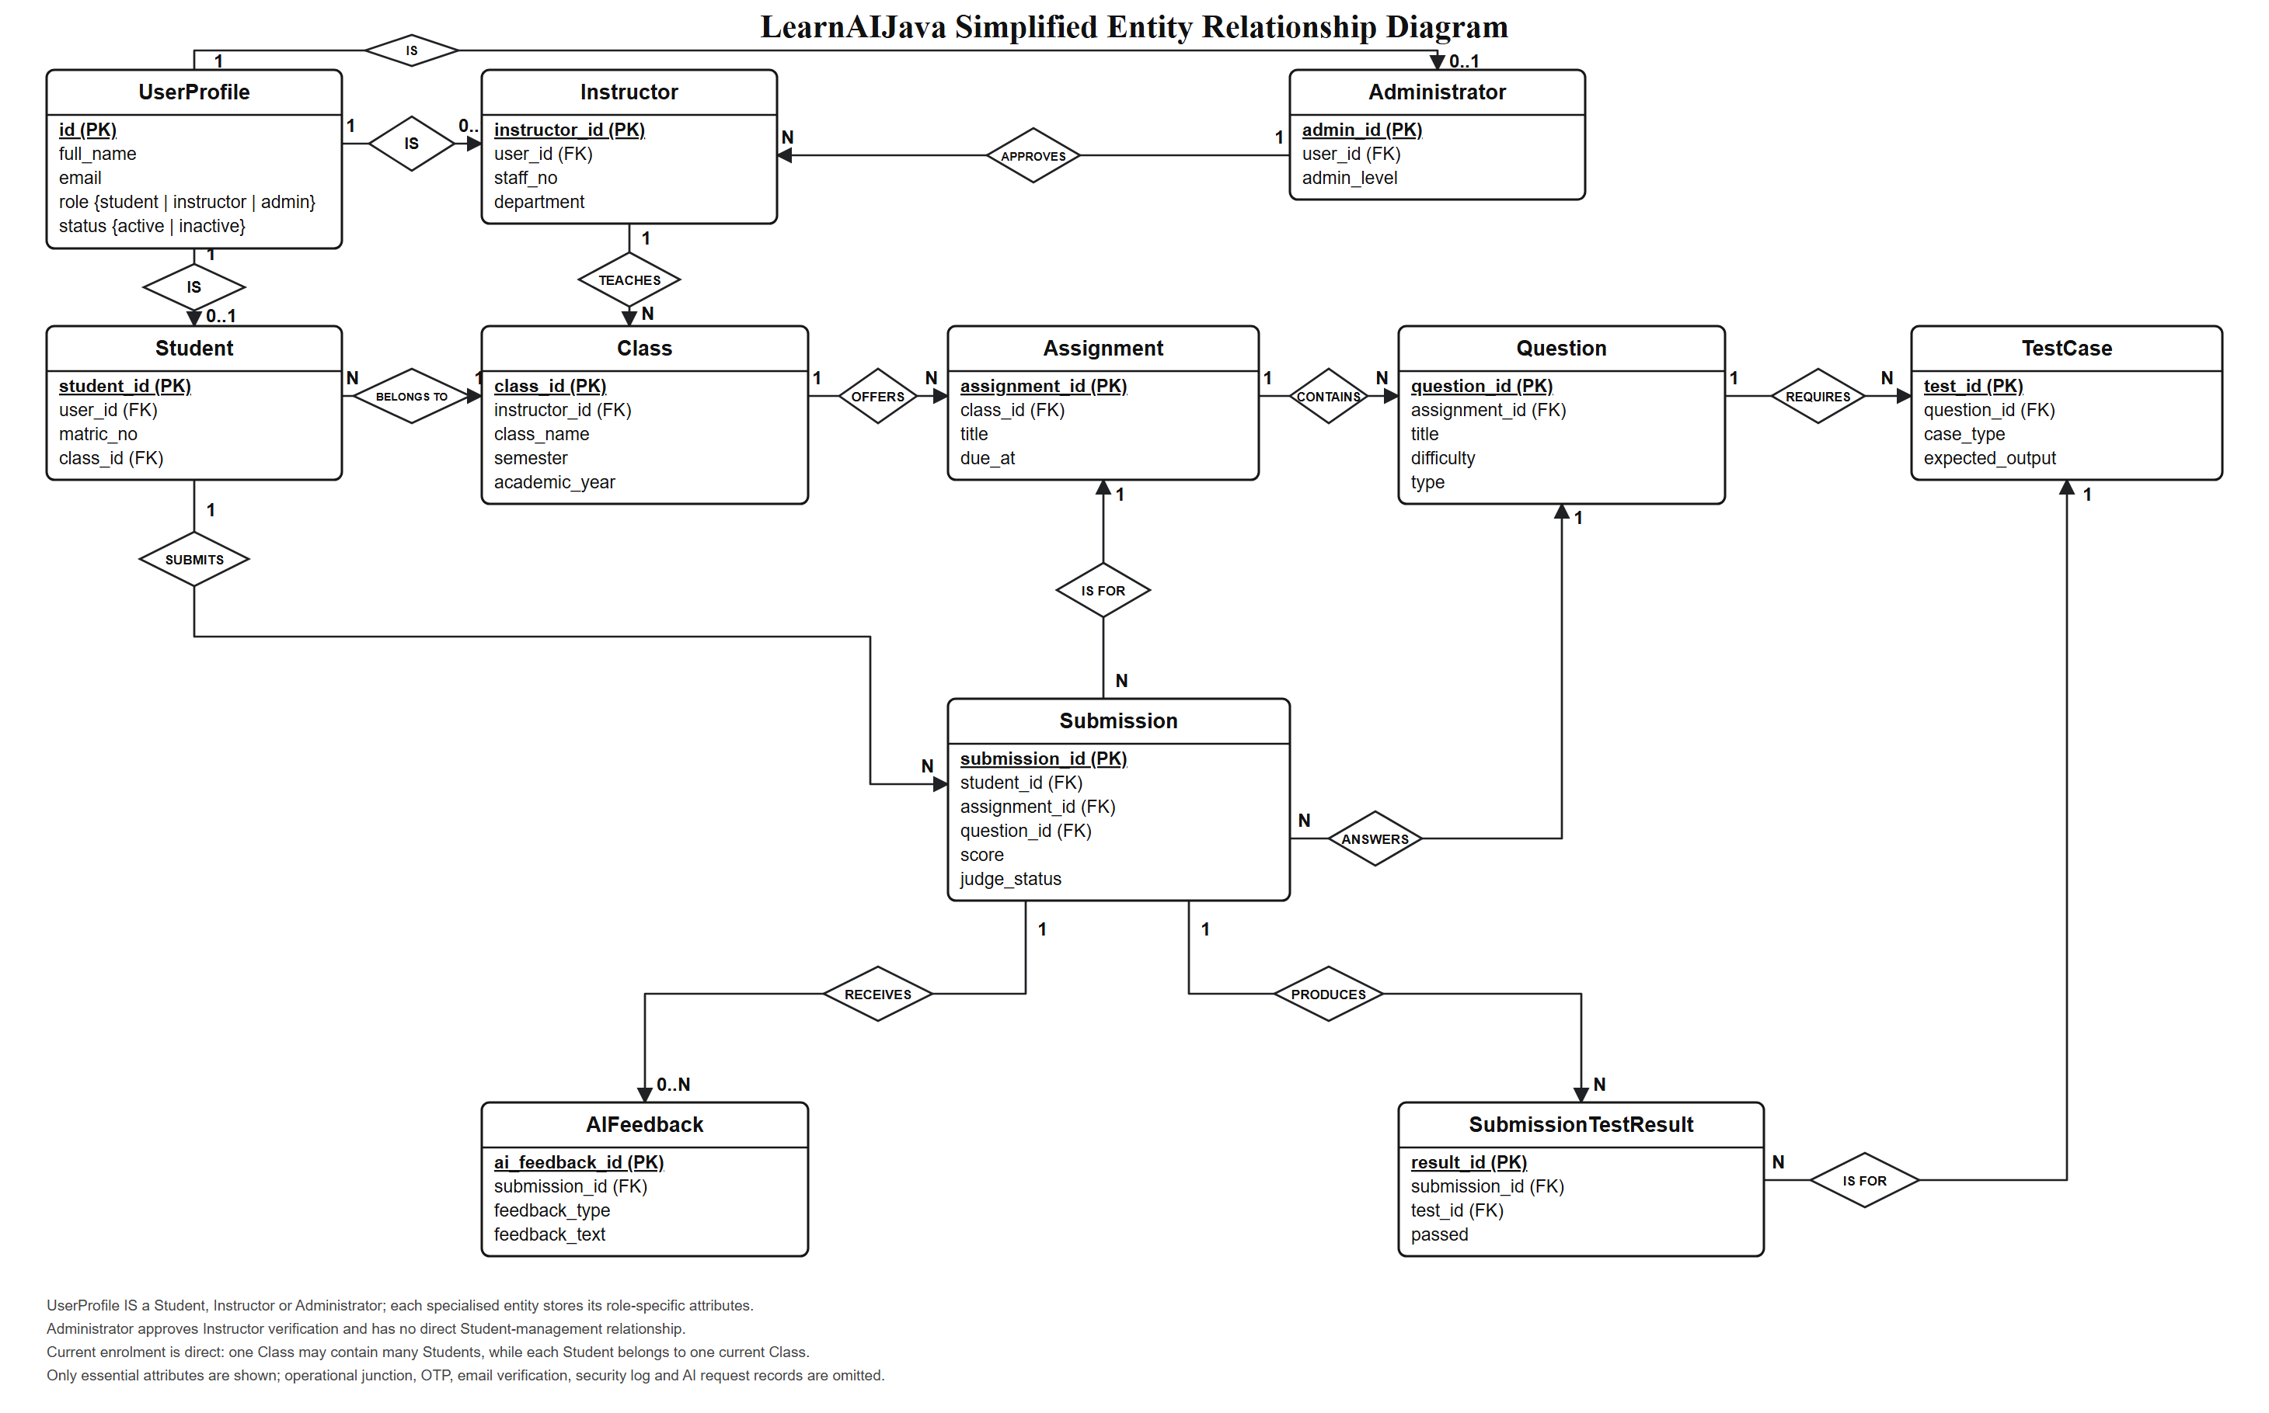
REVISED DATABASE MODEL
The ERD clarifies roles and core learning relationships
Roles use IS relationships; direct 1:N links connect classes, assignments and questions, while Administrator approves Instructor.
6
Notes:
[04:00-04:50]
The ERD shows how those logical stores map to database entities. Profile connects to Student or Instructor records. ClassStudent and ClassInstructor record membership and teaching responsibility. AssignmentQuestion links assignments to their questions, and each question can have several test cases. A submission belongs to one student, assignment and question. SubmissionTestResult stores per-test evidence, while AIFeedback stores guidance. Non-core OTP, email and security-log entities are omitted so the presentation remains readable.

Slide 7
CORE LEARNING WORKFLOW
A failed attempt visibly loops back to evaluation
Instructor
Student
Student + System
System
Student
PROCESS · Prepare assignment
PROCESS · Write code
PROCESS · Run / Evaluate
OUTPUT · Feedback + score
PROCESS · Improve code
Questions + test cases
Edit Main.java
Compile · execute · compare
Judge evidence + likely issue
Revise and retry
NOT ACCEPTED · RETRY
OUTPUT · ACCEPTED → Submit → history + analytics → instructor review
YELLOW = PROCESS
GREEN = OUTPUT
7
Notes:
[04:50-05:50]
The learning loop begins with an assigned question and configured tests. The student writes Java code and can use Run for immediate execution. Evaluate uses the local JDK to compile the program, execute the permitted cases, compare actual and expected output, and calculate a weighted result. When a case fails, feedback identifies the likely problem without exposing the final solution or protected tests. The student revises the code and evaluates again. The accepted result, score and test evidence are recorded for submission history and progress analysis.

Slide 8
CORE ALGORITHMS AND FORMULAS
Three explicit rules determine every result
SCORE
TREND
AI ROLE
1
2
3
Weighted scoring
Trend detection
Explain, never score
Score = 100 × Σ(wᵢ × Iᵢ) / Σwᵢ
Iᵢ = 1 when a test passes; otherwise 0.
ACCEPTED only when every weighted case passes.
Δ = avg(newest 3) − avg(oldest 3)
Δ ≥ 10 → Improving
Δ ≤ −10 → Dropping
Otherwise → Stable
Fewer than four records is also Stable.
Judge evidence → diagnosis → hint
The engine checks status, stderr, stdout and the first failed case in a fixed priority order.
NEVER CHANGES the official score.
8
Notes:
This slide shows the three explicit rules behind each result.
First, official test cases determine the weighted score. A case contributes its weight only when it passes, and acceptance requires every weighted case to pass.
Second, the recent trend compares the newest three records with the oldest three records. A change of ten points or more is improving, minus ten or less is dropping, and the remaining cases are stable.
Third, the AI Engine converts judge evidence into an explanation and hint, but it never changes the official score.

Slide 9
RATING AND RISK STANDARDS
The thresholds are fixed, visible and consistent
BANDS
STUDENT
CLASS
80
R
C
Performance band
Student risk
Class risk
SUCCESS ≥ 80%
WARNING 50–79.99%
DANGER < 50%
No evaluated records → Neutral
HIGH avg < 50% OR compile ≥ 50% OR wrong ≥ 60%
MEDIUM avg < 70% OR compile ≥ 30% OR wrong ≥ 40%
LOW otherwise
High is checked before Medium.
HIGH avg < 50% OR risk students ≥ 5 OR completion < 50%
MEDIUM weak topic < 55% OR any risk student OR completion < 70%
LOW otherwise
Deterministic rules—not ML confidence.
9
Notes:
The rating and risk standards are deterministic thresholds, not machine-learning probabilities.
Performance is Success at eighty percent or above, Warning from fifty to seventy-nine point nine nine percent, and Danger below fifty percent.
Student and class risk rules use OR logic. High-risk conditions are checked first, followed by Medium; the result is Low only when neither threshold is triggered.

Slide 10
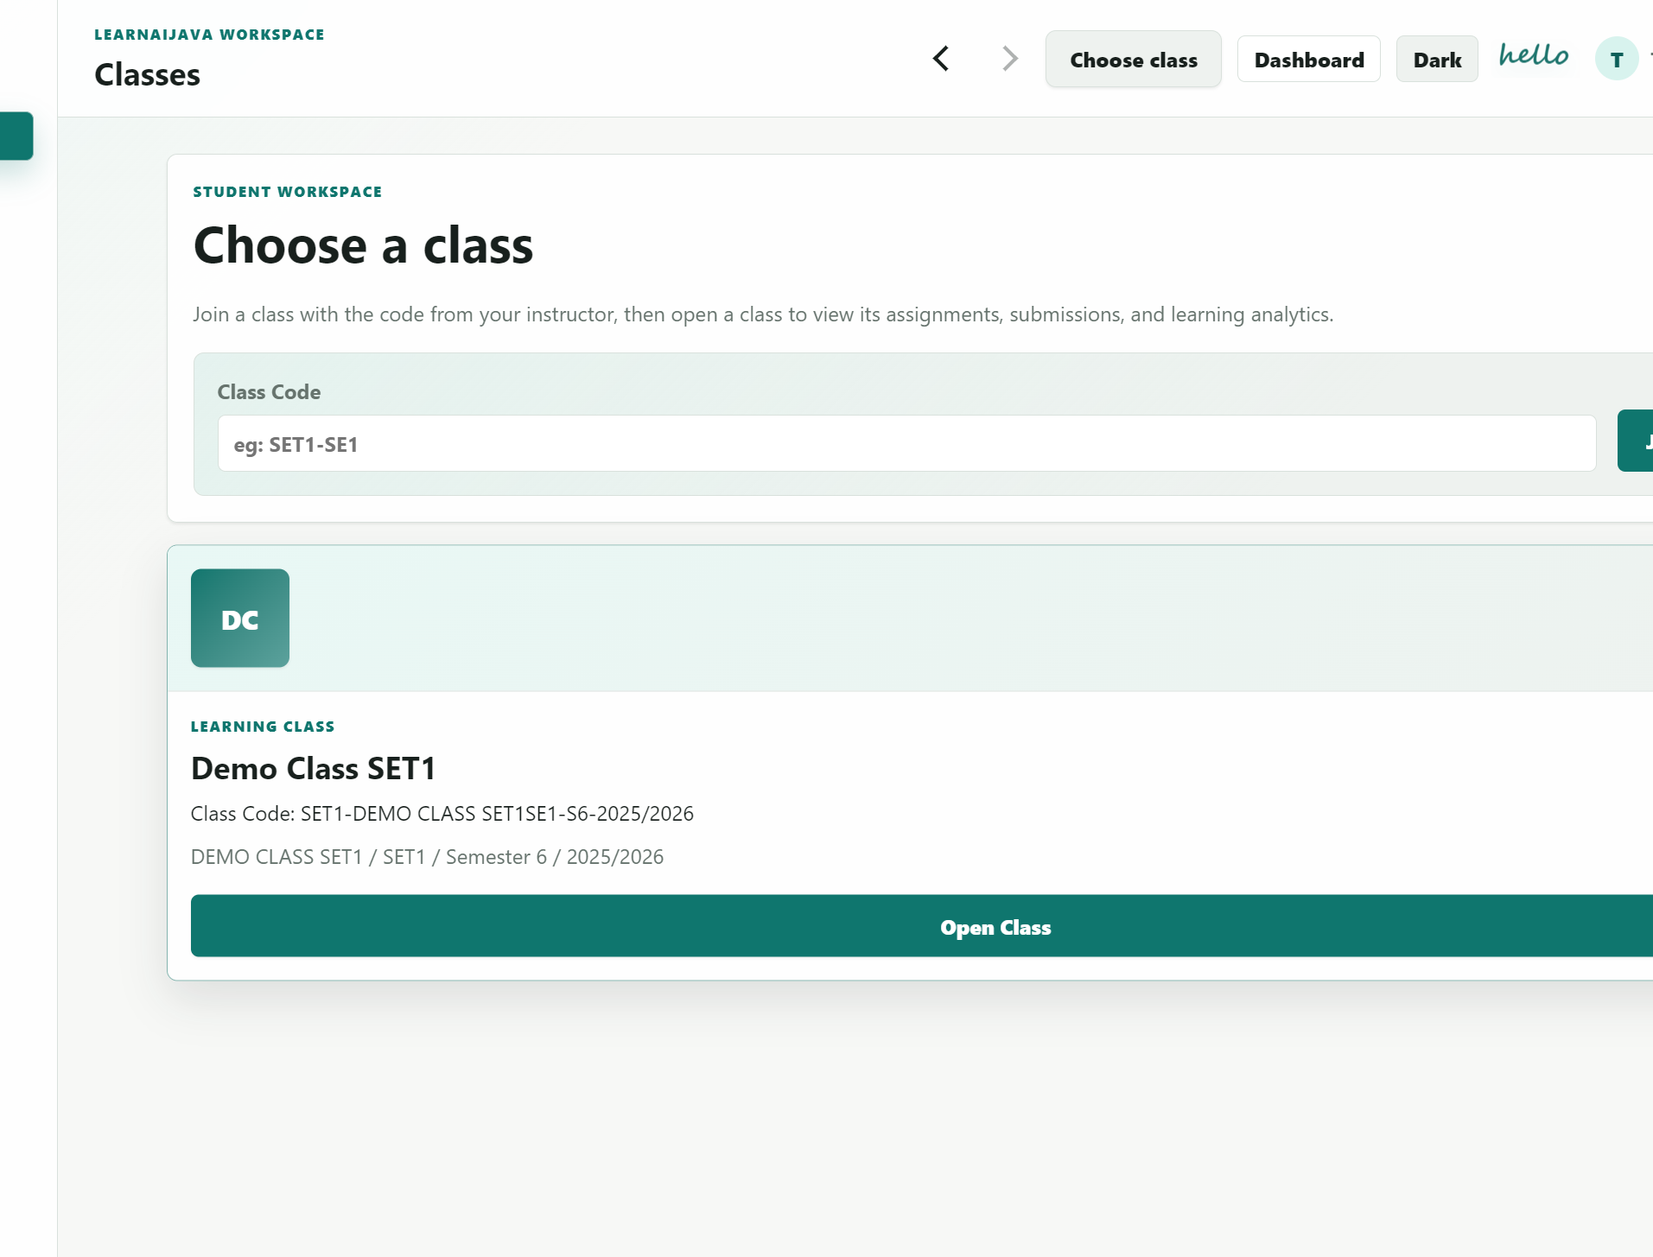
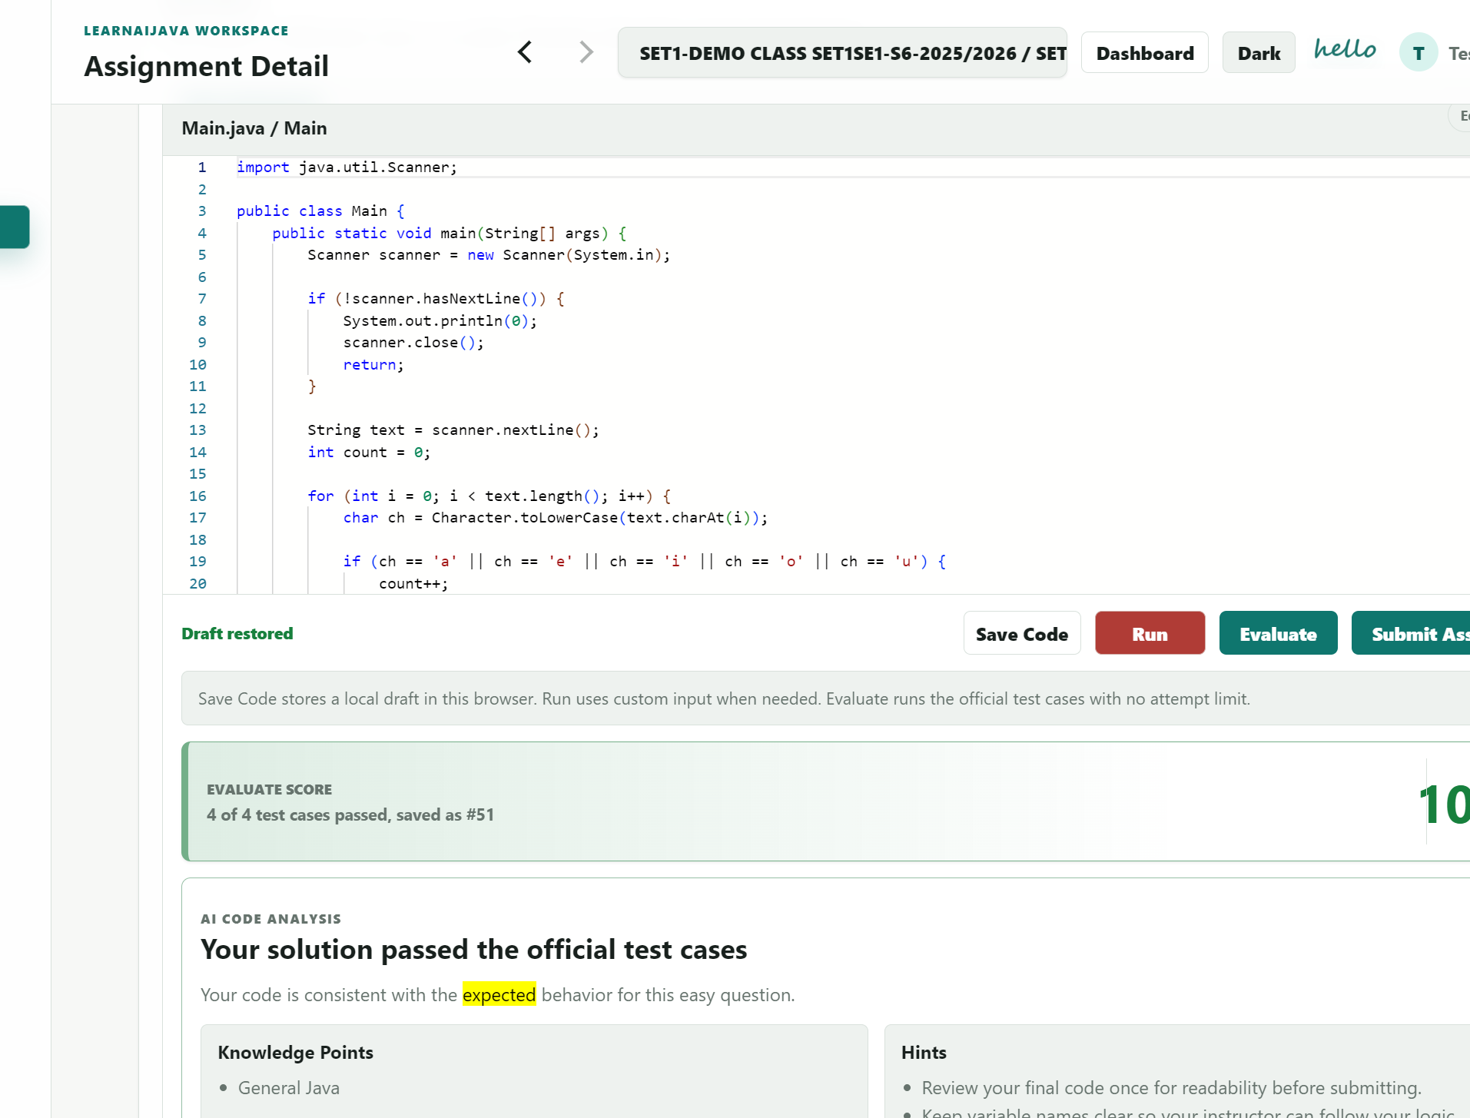
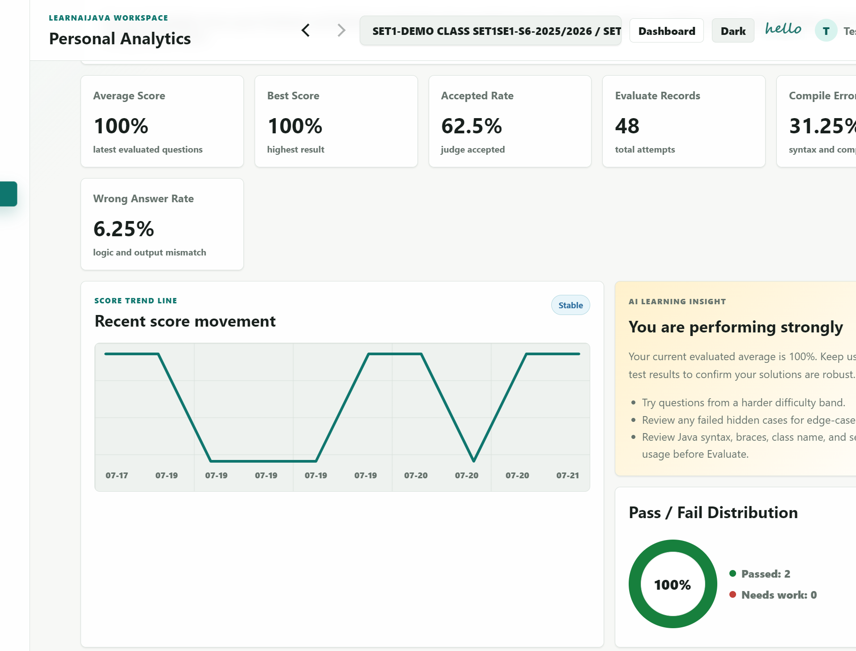
STUDENT EXPERIENCE
Students turn each attempt into measurable progress
PROCESS · Choose a class
PROCESS · Run and evaluate
OUTPUT · Result and progress
YELLOW = PROCESS
GREEN = OUTPUT
10
Notes:
[05:50-06:40]
The student workflow starts from the Test Student class workspace. The student opens an assignment and works in the Java editor, with the requirements, code and actions in one place. Evaluate checks the configured tests. A failed attempt produces targeted feedback, the student corrects the relevant code, and the next evaluation can pass. The system records the score and attempt history, so students can review progress rather than seeing only one correct or incorrect message.
UI replacement note: all three screenshot frames are 350 × 270 px. Replace the two marked slots with final static screenshots before presentation.

Slide 11
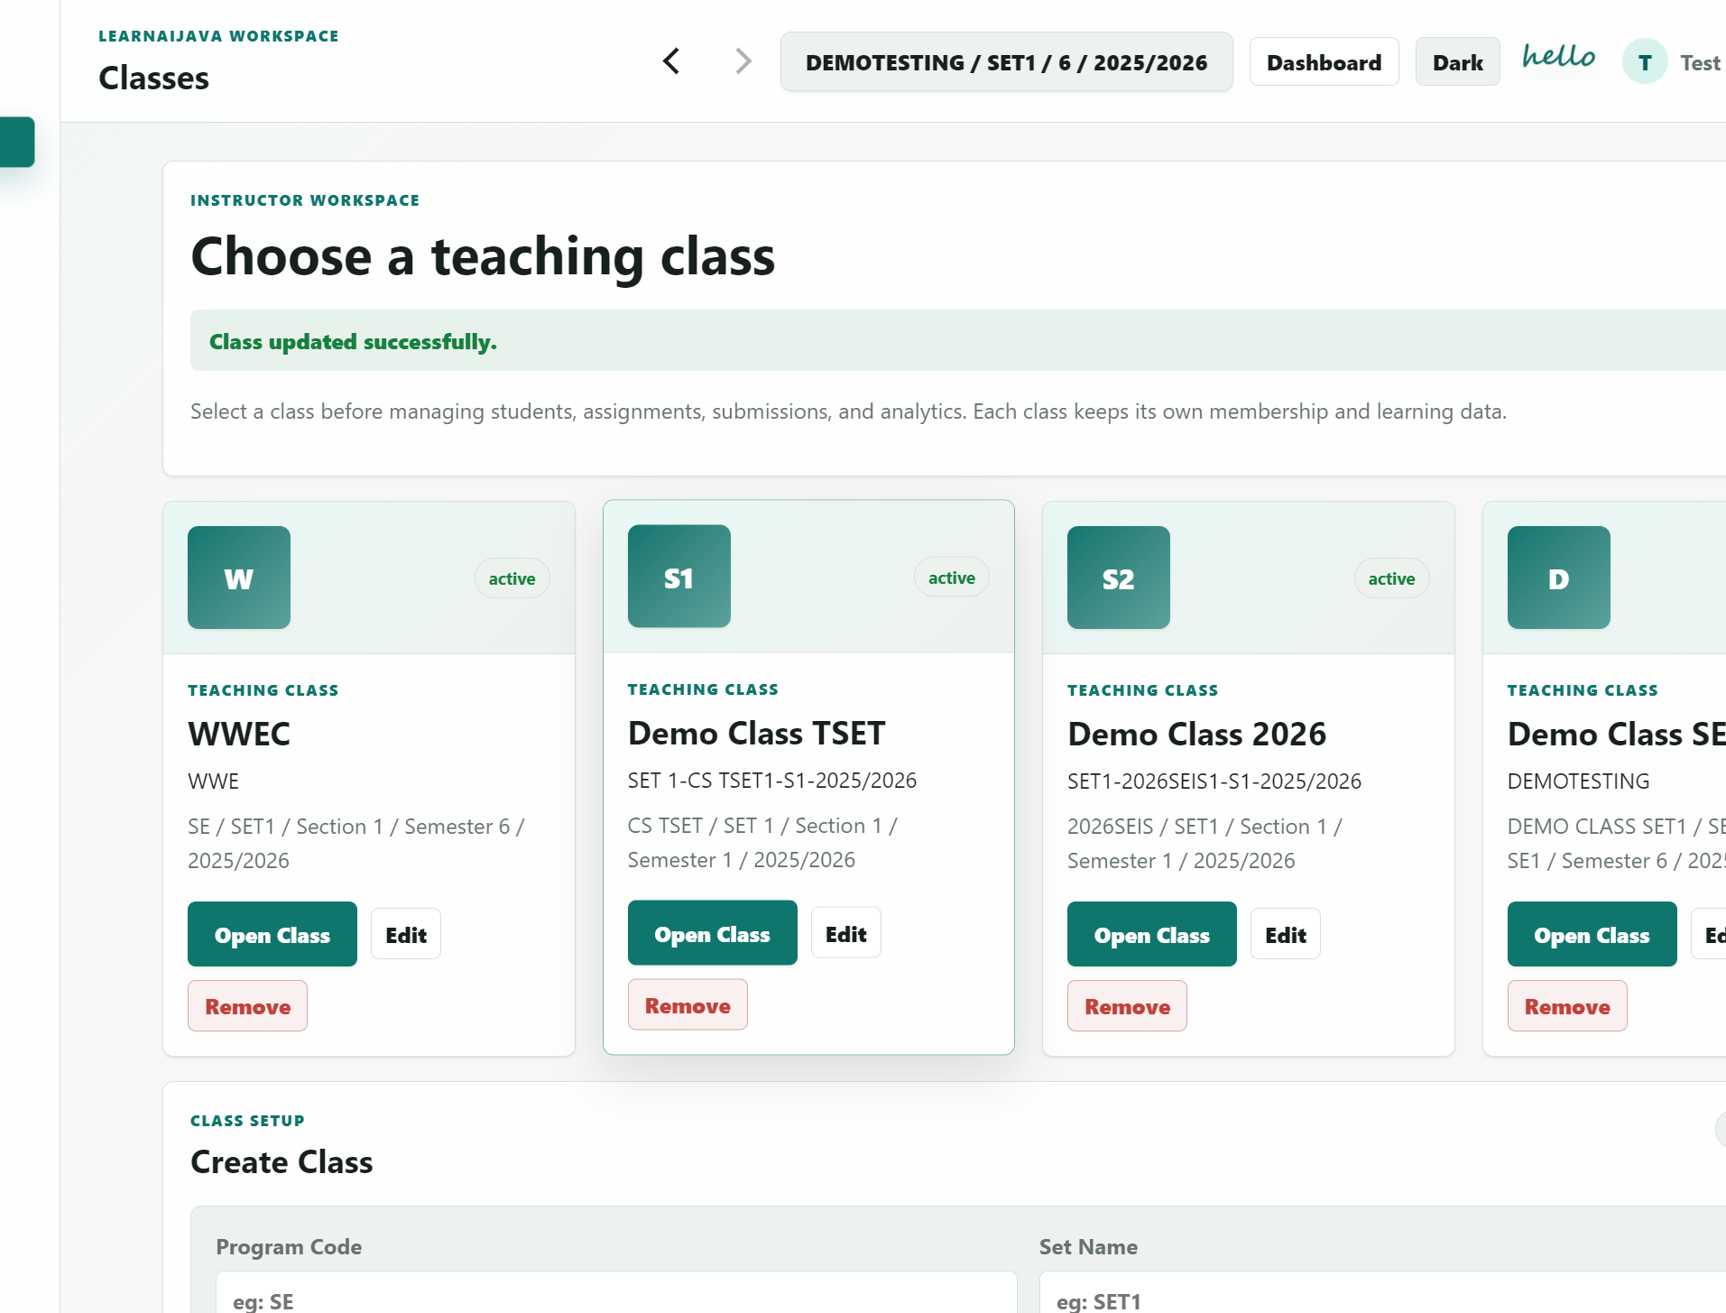
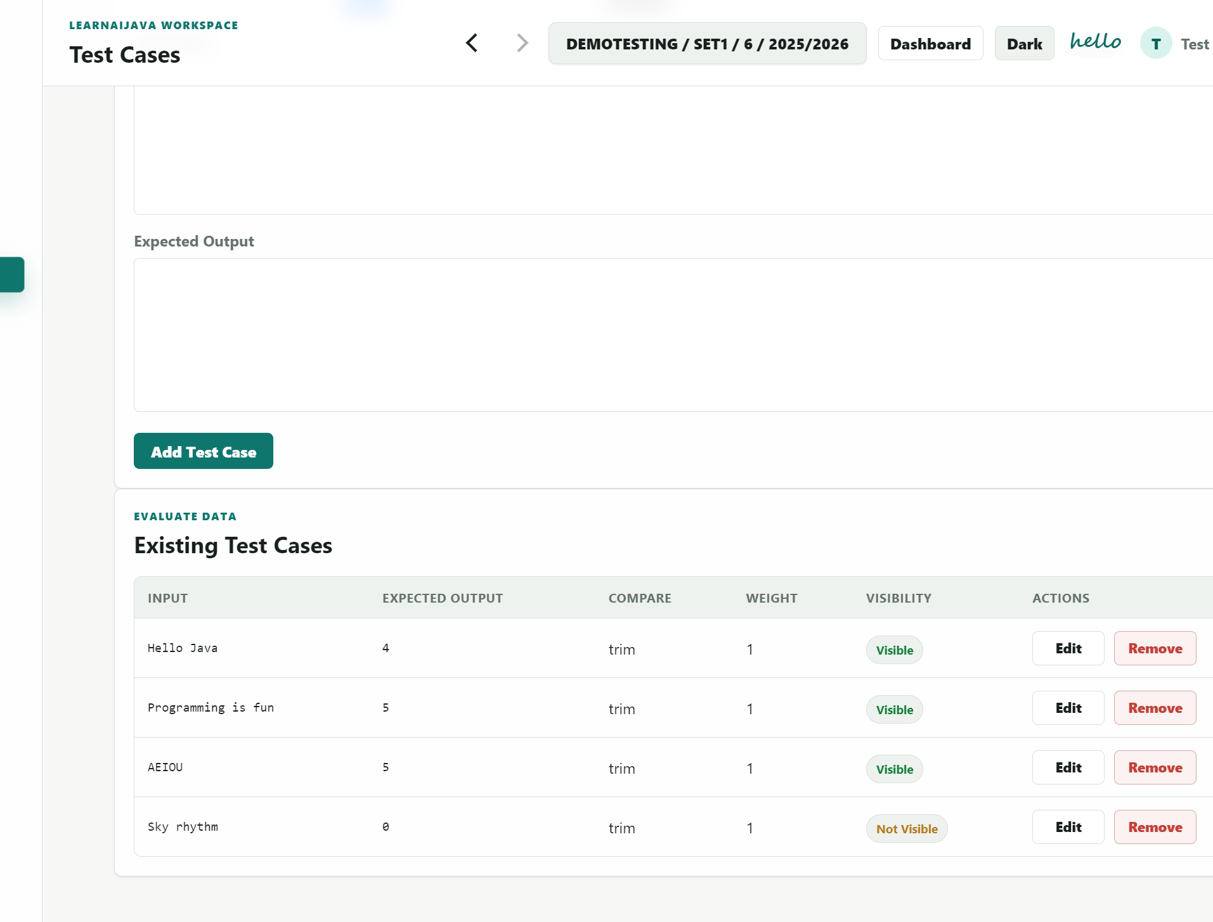
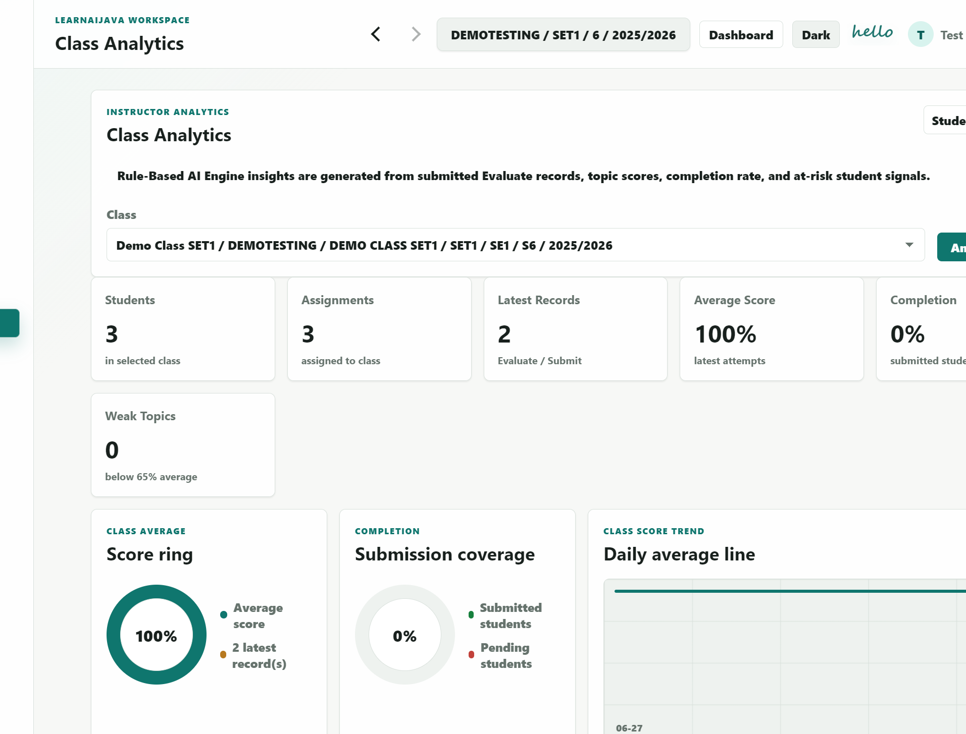
INSTRUCTOR EXPERIENCE
Instructors control content, evidence and learning analysis
PROCESS · Select teaching class
PROCESS · Prepare questions and tests
OUTPUT · Review evidence and analytics
YELLOW = PROCESS
GREEN = OUTPUT
11
Notes:
[06:40-07:30]
The instructor selects a teaching class and manages its membership, assignments, submissions and analytics. Questions and test cases remain private to their instructor owner, and selected questions are combined into assignments. After submission, the same evaluation evidence supports result review, assignment comparison and class or student analytics. The administrator remains outside this teaching workflow and handles only system-level account and approval tasks.
UI replacement note: all three screenshot frames are 350 × 270 px. Replace the two marked slots with final static screenshots before presentation.

Slide 12
SYSTEM TESTING EVIDENCE
Four test layers validated the system before UAT
Functional checks · 10 / 10 passed
2
workflow paths
student + instructor
2
regression boundaries
private questions + assignment-only
10
Evaluate / AI scenarios
accepted, errors, timeout + hidden failure
D8 Chapter 4: functional, workflow, regression and AI feedback testing.
12
Notes:
[07:30-08:25]
Testing covered functionality, end-to-end workflow, regression, feedback quality and user acceptance. Ten anonymous testers participated: eight students and two instructors. The strongest result was data ownership at 4.9 out of 5. Java Run and Evaluate and AI feedback both scored 4.8, and function completeness scored 4.7. Speed and stability scored 3.7, identifying the clearest improvement area for cloud-dependent pages. The results support the learning workflow while giving a specific technical priority.

Slide 13
USER ACCEPTANCE TESTING
Nine users validated the core learning workflow
UAT mean rating / 5
9
anonymous testers
8 students · 1 instructor
4.9
highest result
Data ownership
3.7
priority for improvement
Speed and stability
Comments supported AI feedback and automatic checking; guidance and loading speed remain priorities.
13
Notes:
[07:30-08:25]
Testing covered functionality, end-to-end workflow, regression, feedback quality and user acceptance. Ten anonymous testers participated: eight students and two instructors. The strongest result was data ownership at 4.9 out of 5. Java Run and Evaluate and AI feedback both scored 4.8, and function completeness scored 4.7. Speed and stability scored 3.7, identifying the clearest improvement area for cloud-dependent pages. The results support the learning workflow while giving a specific technical priority.

Slide 14
LIVE DEMO
Five-minute live demo
LJ
Assignment → Evaluate → Feedback → Improve → Submit
The same attempt becomes student progress and instructor evidence.
SWITCH TO LEARNAIJAVA
14
Notes:
[09:25-10:00; live demo 10:00-15:00]
I will now demonstrate the complete workflow using prepared test accounts. In five minutes, I will open a student assignment, evaluate an incomplete solution, use the feedback to correct it, evaluate again, submit the accepted result, and show the student's history and progress. I will then switch to the Test Instructor view to verify that the same evidence is available for submission review and class analytics. Credentials, notifications and personal information will remain hidden.

Slide 15
OUTCOMES AND FUTURE ROADMAP
The next step is smarter, LLM-assisted feedback
5/5
3
NEXT
Objectives achieved
Main limitations
Future development
Complete student workflow
Explainable weighted scoring
Protected hidden tests
Private instructor content
Traceable learning analytics
Execution sandbox needs hardening
Cloud-dependent loading can be slow
Rule-based feedback is less flexible
Connect an external large language model
Ground explanations in judge evidence
Personalise hints using topic and attempt history
Protect hidden tests and final answers
Keep official scoring rule-based and auditable
15
Notes:
[08:25-09:25]
The prototype achieved all five project objectives and demonstrates a complete, traceable learning workflow. Its present limitation is that rule-based feedback is consistent but less flexible. A future version can connect to an external large language model to produce richer explanations and more personalised hints. The model should be grounded in the judge result, compiler or runtime evidence, course topic and the student's attempt history. Instructor-controlled prompts, output filtering and audit logs should prevent final-answer leakage and protect hidden test cases. Most importantly, the large language model should improve explanation only; official scoring must remain deterministic, rule-based and auditable.

Slide 16
THANK YOU
LJ
Questions are welcome
LearnAIJava turns every attempt into evidence for learning
Assignment → evaluation → feedback → measurable progress
Test accounts only; no personal information is displayed
Notes:
[14:45-15:00]
This concludes the LearnAIJava presentation. The project turns each Java attempt into explainable feedback and traceable learning evidence while keeping scoring deterministic. Thank you for your attention. I welcome your questions.

Slide 17
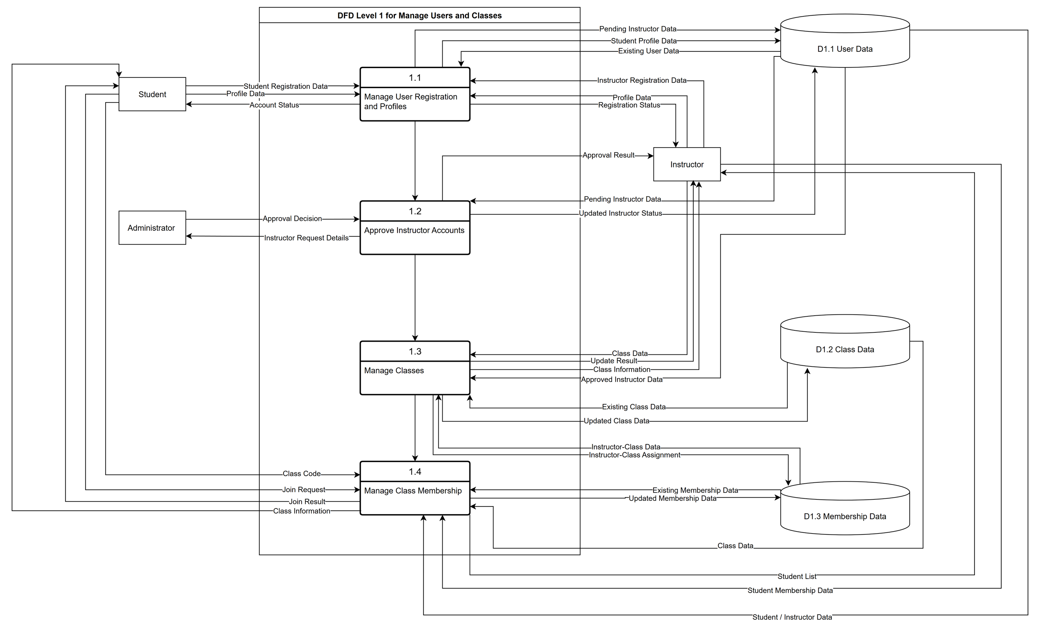
APPENDIX — DFD LEVEL 1
Process 1.0: Manage Users and Classes
Users, approval, classes and membership. Open editable .drawio source
A1
Notes:
Appendix A1 decomposes Process 1.0 and shows how user profiles, class membership, instructor approval and related records are handled without assigning student-management responsibility to the administrator.

Slide 18
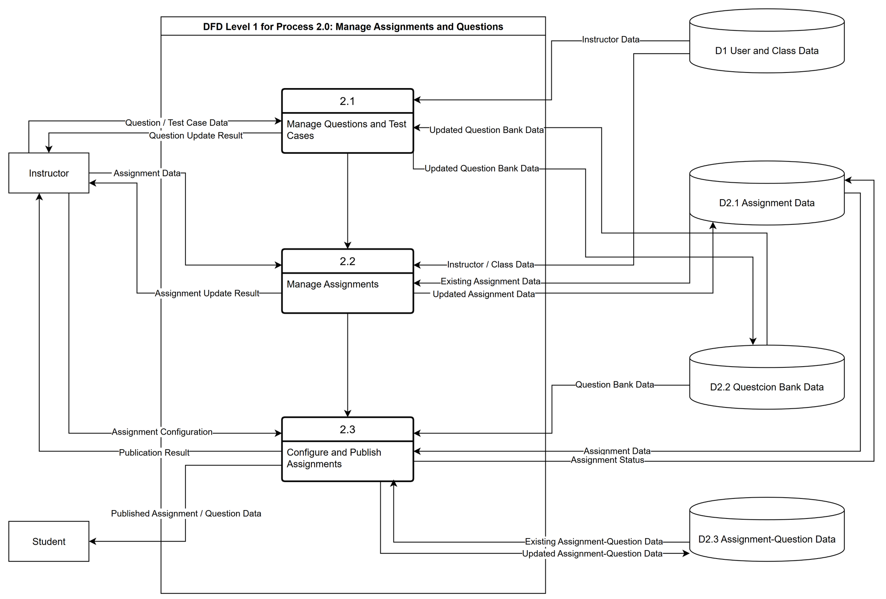
APPENDIX — DFD LEVEL 1
Process 2.0: Manage Assignments and Questions
Questions, tests and assignment composition. Open editable .drawio source
A2
Notes:
Appendix A2 decomposes Process 2.0 into question-bank management, test-case configuration, assignment creation and assignment updates. These flows correspond to the database entities shown in the ERD.

Slide 19
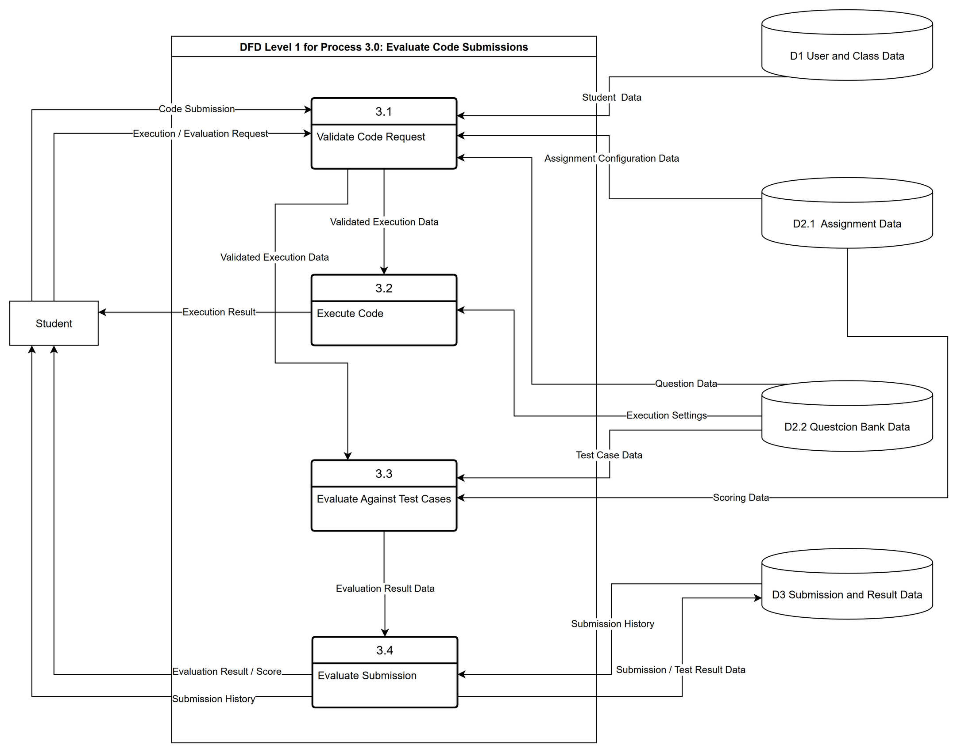
APPENDIX — DFD LEVEL 1
Process 3.0: Evaluate Code Submissions
Validation, execution, scoring and evidence. Open editable .drawio source
A3
Notes:
Appendix A3 shows the detailed evaluation flow: prepare context, compile, execute, compare outputs and record the result. The stored submission and test evidence feeds the next process.

Slide 20
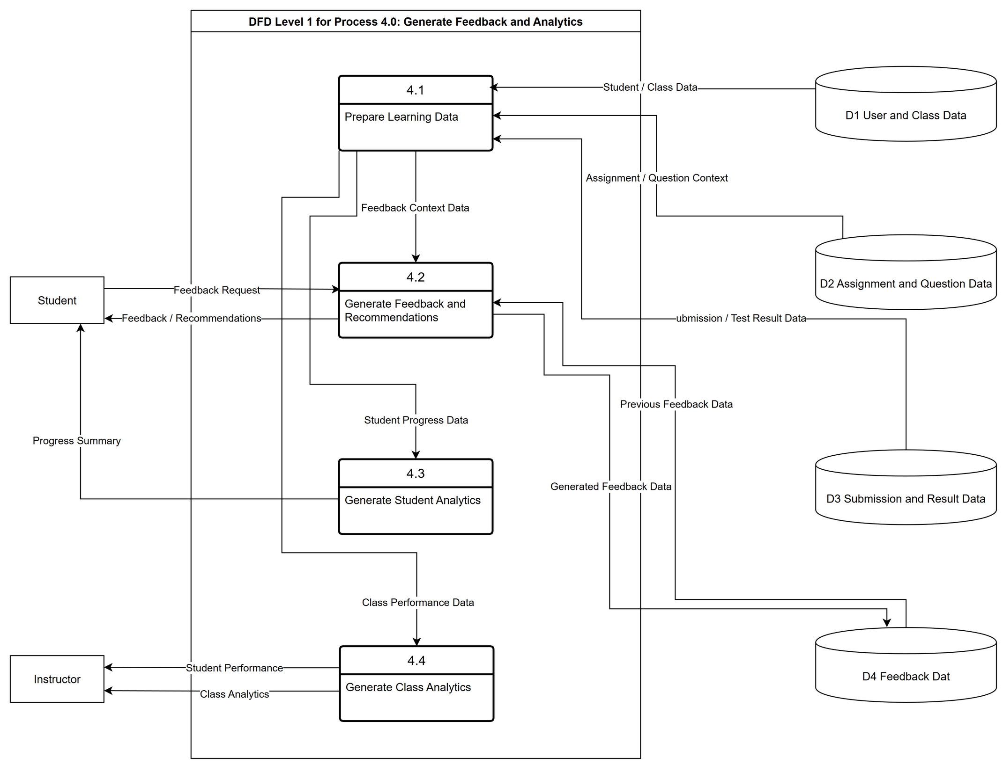
APPENDIX — DFD LEVEL 1
Process 4.0: Generate Feedback and Analytics
Feedback and analytics from stored evidence. Open editable .drawio source
A4
Notes:
Appendix A4 decomposes feedback and analytics into evidence preparation, feedback generation, progress aggregation and class analysis. The administrator learning-summary flow is intentionally absent.

